Slide 1
Facial Emotion Detection
MIT Applied Data Science Program 2023
Capstone Project Live Presentations
Presented By Jayani Imalka • October 22 2023

Slide 2
Problem Definition
Facial emotion detection is an important topic in the fields of computer vision and artificial intelligence
It plays a crucial role in understanding human behavior when interact with machines
55% of communication of sentiment takes place through facial expressions and other visual cues
Application Areas:
Human-computer interactions
Enhancing healthcare and mental health services
Autism Spectrum Disorder (ASD) Diagnosis, telemedicine and virtual therapy sessions
Various industries and domains where emotions play a significant role.
Virtual Reality (VR) and Augmented Reality (AR)
Advanced driver assistance systems (ADASs)
Gaming and Entertainment

Slide 3
Objective
Accurately predict facial emotions using deep learning techniques
A multi-class classification algorithm
Predict 4 different classes of the Facial Emotions: Happy, Sad, Neutral and Surprise

Slide 4
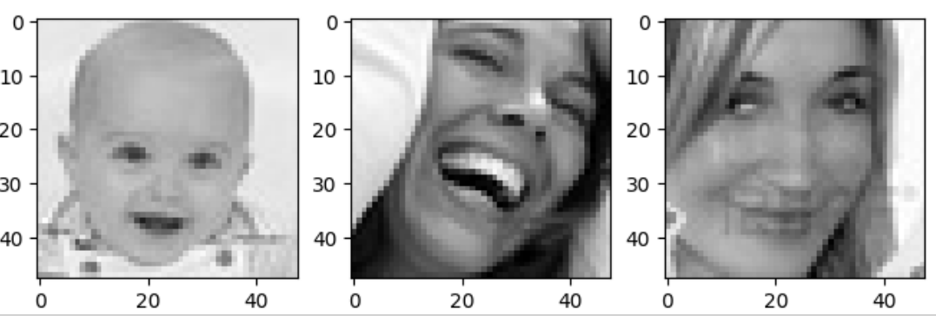
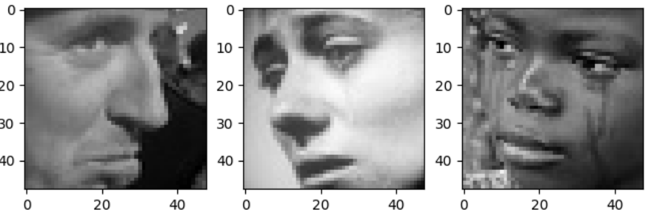
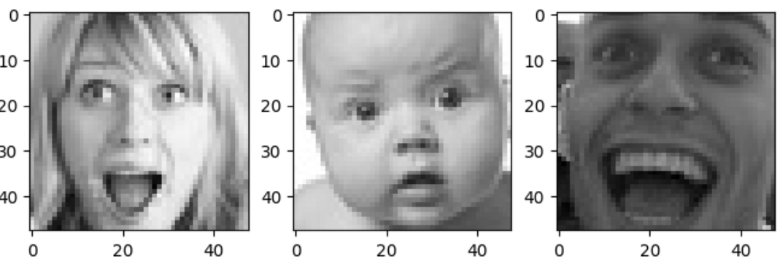
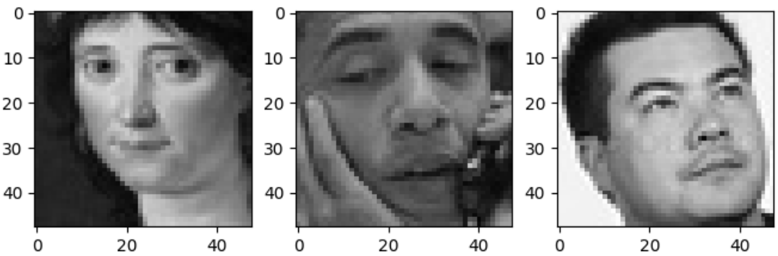
The Dataset
The data set consists of 3 folders
'test', 'train', and 'validation'.
Each of these folders has four subfolders with images of people who have facial expressions of
Happy
Sad
Surprise
Neutral

Slide 5
Solution Approach
Data Exploration
Preprocessing
Model Building
1. CNN
Base NN Second NN Complex NN
(Gray Scale, RGB) (Gray Scale, RGB) (Gray Scale)
2. Transfer Learning Models
VGG 16 Model ResNet V2 Model EfficientNet Model

Slide 6
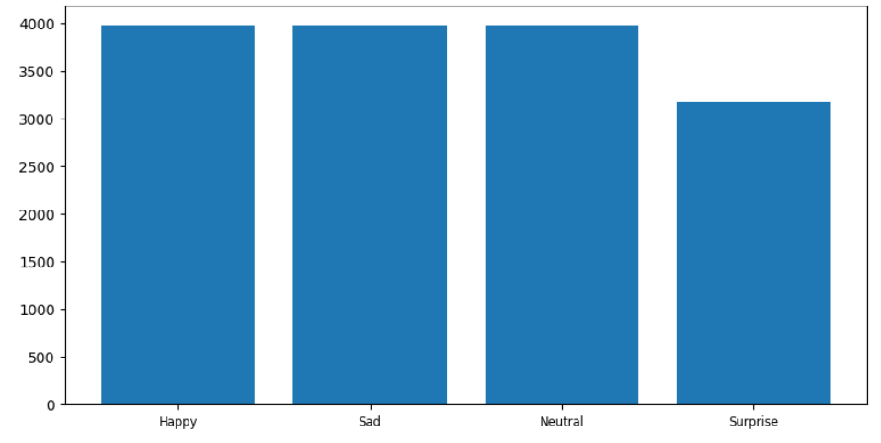
Data Exploration
Data Distribution of Classes
Training Dataset
Images in each sub folder in training dataset
happy: 3976
sad: 3982
neutral: 3978
surprise: 3173

Slide 7
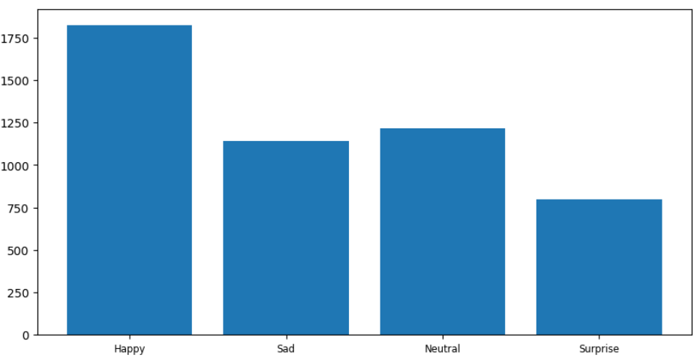
Data Exploration
Data Distribution of Classes
Validation Dataset
Images in each sub folder in validation dataset
happy: 1825
sad: 1139
neutral: 1216
surprise: 797

Slide 8
Preprocessing
Normalization
Data augmentation
Flipping
Brightness
Shear

Slide 9
Model Building Key Findings
Visualizing subsets of data helped to identify unique features lead to differentiate images among classes
Base model shown the best performance with a 87% training accuracy & 78% testing accuracy for RGB color mode but still shown overfitting
Second CNN model shown an unusual behaviour which validation accuracy is higher than training accuracy in both rgb and grayscale color modes
Transfer learning models surprisingly reflected a poor behaviour
Complex CNN close to large transfer learning models performed better than all the transfer learning models developed here but still failed to surpass the base model performance

Slide 10
Comparison of various techniques and their relative performance
Model | Color Mode | Training Accuracy | Validation Accuracy | Testing Accuracy | Training Time (1st epoch)
Base CNN (Relu) | Grayscale | 82.54% | 70.83% | 79.69% | 22s
 | RGB | 87.23% | 71.53% | 78.12% | 33s
Second CNN (LeakyReLU) | Grayscale | 71.26% | 73.50% | 78.12% | 25s
 | RGB | 69.93% | 74.50% | 78.12% | 30s
Complex CNN (Relu) | Grayscale | 77.91% | 71.33% | 71.88% | 19s
VGG 16 | RGB | 48.29% | 54.73% | 46.09% | 43s
ResNet V2 | RGB | 38.94% | 20.47% | 25.78% | 53s
EfficientNet | RGB | 26.55% | 24.43% | 25.00% | 59s

Slide 11
Final Model Solution
Base CNN for RGB color mode was able to classify images of Happy emotion and Surprise emotion with a good performance regardless of class imbalance present (On average 93% happy images and 90% of surprise images classified correctly)
The model is majorly confused between Neutral and Sad emotions
Performance of Neutral and Sad classes must be further improved
Overall, the model appears to perform well for some classes but may need improvement before implementation

Slide 12
Insights
For this particular dataset, simple models gave higher accuracy.
As the model complexity increases model performance decreased.
Even the best performing model shown overfitting, to overcome it is recommended to
Try several data augmentation more suitable for the dataset such as random rotations, translations, flips, and zooms
Hyperparameter Tuning
Implement early stopping
Further reduce Model Complexity by reducing the number of convolutional layers and filters
Apply Regularization Techniques

Slide 13
Conclusions and Recommendations
Solution model must be further improved as it learns to perform well on the training data but fails to generalize to unseen data
It is important to address the class imbalance of the dataset
Model is tested only for original black and white images, hence it is recommended to run the model over images collected from different lighting conditions
To overcome poor performance of Transfer Learning models it is recommended to build own architecture on top of each models' Transfer layers
As the model complexity increases execution time also increased hense we can conclude that the selected model is both efficient and accurate

Slide 14
Implementing the solution
Rough cost estimate for deploying the CNN model
(For deploying a small-sized CNN model: 5.85MB)
Infrastructure Costs
A cost-effective option could be an AWS EC2 instance like a t2.micro (1 vCPU, 1GB RAM) - $8.39 per month
Data Transfer Costs
vary depending on the amount of data transferred
Storage Costs
Storing the model in Amazon S3 - $0.01 per month
Software Costs
Specific deployment software, TensorFlow Serving or Docker containers
Personnel Costs
Salaries of DevOps engineers, data scientists, or ML engineers
Scaling and Redundancy
Maintenance and Support
Security Costs

Slide 15
Potential benefits of CNN model
High Accuracy
Automatic Feature Extraction
Real-Time Processing
Multimodal Recognition
Wide Range of Applications
Healthcare, Human-Computer Interaction, Market Research, Security
Accessibility and Inclusivity
Emotion Understanding
Personalization
Data-Driven Insights
Enhanced Security
access control, fraud detection, identity verification
Human-Robot Interaction

Slide 16
Thank You!

Slide 17
APPENDIX

Slide 18
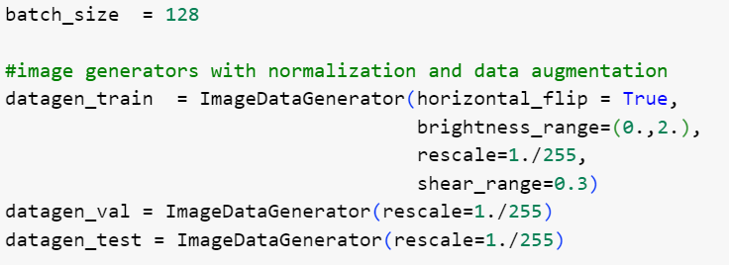
Solution Code Highlights

Slide 19
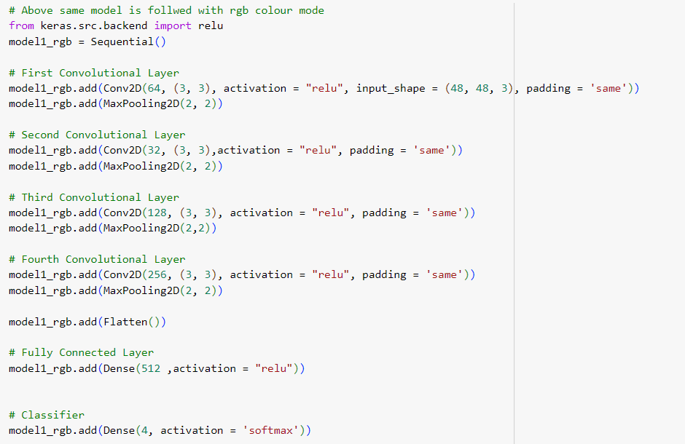
Solution Code Highlights contd.,

Slide 20
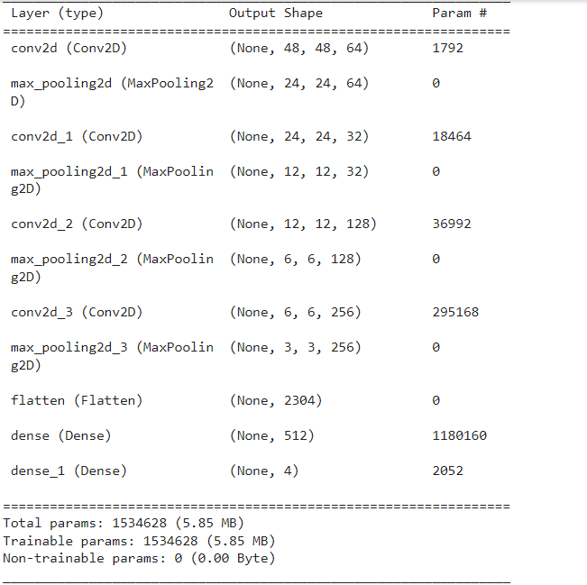
Solution Code Highlights contd.,

Slide 21
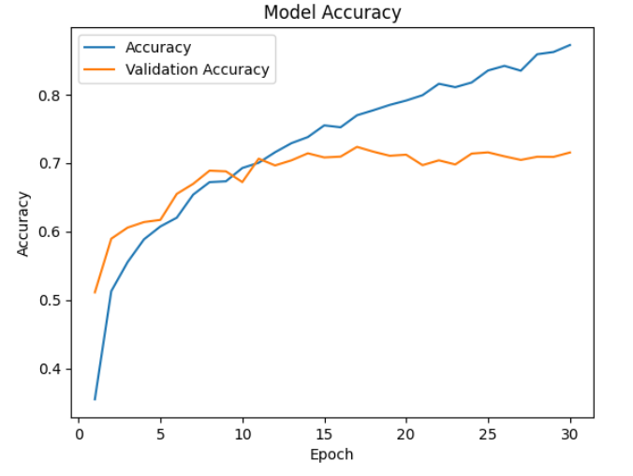
Solution Code Highlights contd.,

Slide 22
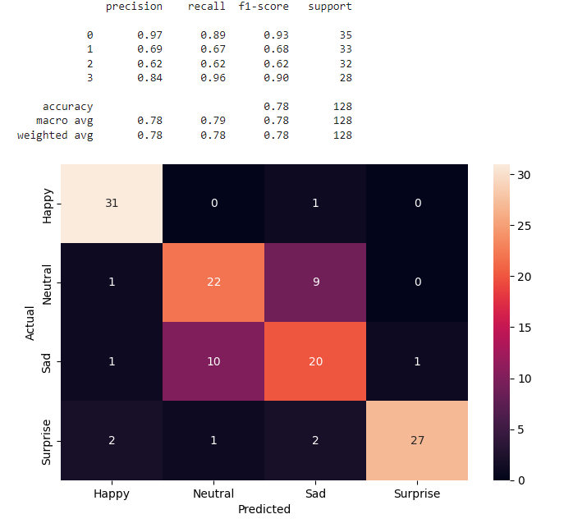
Classification Report & Confusion Matrix

